Slide 1
COVID-19 Relief – PPP Update & Forgiveness Application
Presented by:
Brinker Simpson & Company, LLC

Slide 2
DISCLAIMER
This analysis is not tax or legal advice and is not intended or written to be used, and cannot be used, for purposes of avoiding tax penalties that may be imposed on any taxpayer.
The information contained herein is general in nature and based on authorities that are subject to change. Brinker Simpson & Company, LLC guarantees neither the accuracy nor completeness of any information and is not responsible for any errors or omissions, or for results obtained by others as a result of reliance upon such information. Brinker Simpson & Company, LLC assumes no obligation to inform the reader of any changes in tax laws or other factors that could affect information contained herein. This publication does not, and is not intended to, provide legal, tax or accounting advice, and readers should consult their tax advisors concerning the application of tax laws to their particular situations.

Slide 3
AGENDA
Paycheck Protection Program – Update, Outlook &Forgiveness
Main Street Lending Program – Overview and information
Q & A
Overview of COVID19 Lending Programs

Slide 4
Overview - Paycheck Protection Program
Loan amount = 2.5 X average monthly payroll costs
  Salaries, wages, bonuses/ hazard pay, employer portion of retirement benefits and health insurance (but not for owner’s), net self employment income, and others
Funds spent over 8 weeks following disbursement
Forgiveness available if certain criteria are met within the eligible timeframe:
  75% of funds used for payroll costs – **may be reduced to 60%**
  Restoration of headcount
  Restoration of compensation levels
Portion of a PPP loan that isn’t forgiven must be repaid over two years – after a six-month deferral period (up to 1yr at lender discretion) – at an interest rate of 1%. **maturity to potentially be increased to 5 years**

Slide 5
Paycheck Protection Program Flexibility Act
On Friday May 28th, the House of Representatives passed the Paycheck Protection Program Flexibility Act. The Senate is expected to pass a version of the bill this week. Some of the highlights of the House version are below:
8 week covered period increased to 24 weeks or December 31, 2020 (eliminates June 30) – whichever is earlier;
75% of forgivable amount spent on payroll costs reduced to 60%;
Allows deferral of payroll taxes beyond date forgiveness decision is granted;
Maturity increased from 2 years to 5 years
Exemption based on employee availability paragraph added
Offers exemption for :
  inability to rehire anyone who was an employee as of 2/15/20 if there were also unsuccessful efforts to hire similarly qualified employees before 12/31/20
  is able to document an inability to return to the same level of business activity as such business was operating at before February 15, 2020, due to compliance with requirements established or guidance issued by the Secretary of Health and Human Services, the Director of the Centers for Disease Control and Prevention, or the Occupational Safety and Health Administration during the period beginning on March 1, 2020, and ending December 31, 2020, related to the maintenance of standards for sanitation, social distancing, or any other worker or customer safety requirement related to COVID–19.

Slide 6
Paycheck Protection Program Flexibility Act – Senate bill
On Friday May 28th, the House of Representatives passed the Paycheck Protection Program Flexibility Act. The Senate is expected to pass a version of the bill this week. Some of the highlights of the House version are below:
Senate expected to propose 16 week covered period
75% of forgivable amount must be spent on payroll costs is expect to remain unchanged
If the Senate version is passed, a committee may be called to reconcile and resolve differences between the competing versions. Alternatively, the Senate could choose to pass an amended version of the House bill which would then return to the House for additional votes

Slide 7
Paycheck Protection Program – Forgiveness Application – What’s New?
On Friday May 15th after the close of business, the PPP Forgiveness Application was released. Some of the highlights of the application are below:
Alternate Payroll Covered Period Election
Paid and incurred are BOTH eligible as forgivable payroll costs
Exclusion of Owner Benefits
FTE = Total hours worked / 40 hours
  Option to select simplified method where employees who worked 40 hours = 1 and any employee who did not = .5
Confirmation of $100K annualized pay period
Sole Props 2019 - 52/8; no need to confirm 2020 income
Salary reduction is measured against the 1st quarter of 2020
Relief for headcount reduction related to employees fired for cause and / or employees who choose not to return to work

Slide 8
Paycheck Protection Program – Forgiveness Step by Step
Determine Payroll Costs:
Separate > $100K employees (including Ees receiving annualized rate of >$100k at any time in 2019 and enter in Schedule A worksheet Table 1
Calculate the sum of eligible nonpayroll costs by category (Business Mortgage Interest Payments, Business Rent Payments, Business Utility Payments) and enter on application
Calculate adjustment for Salary / Hourly Reduction and subtract amount from payroll and non payroll costs
Determine FTE reduction factor and multiply by number from step 3
If 75% threshold is met; this is your forgivable amount. If not, recalculate to meet threshold to determine forgivable amount

Slide 9
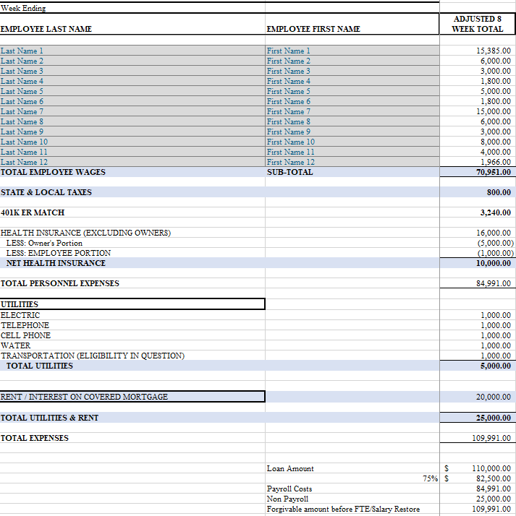
Example – Loan Calc before FTE/ Salary Reduction

Slide 10
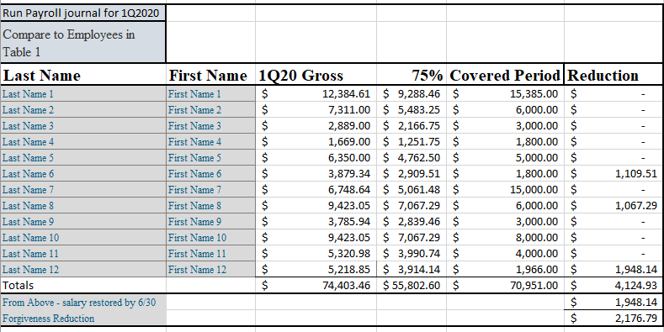
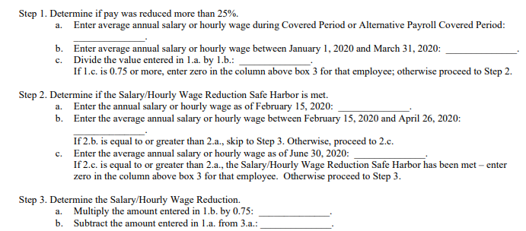
Salary @ 75% Calculation
Compares on an employee by employee basis the average salary or hourly wage paid over the covered period to 1Q20
For each employee paid during the covered period , enter their salary or hourly wage
Compare each employee to average annual over first quarter of 2020
Safe Harbor
  Salary level restored by 6/30/2020
See Calculation from app below

Slide 11
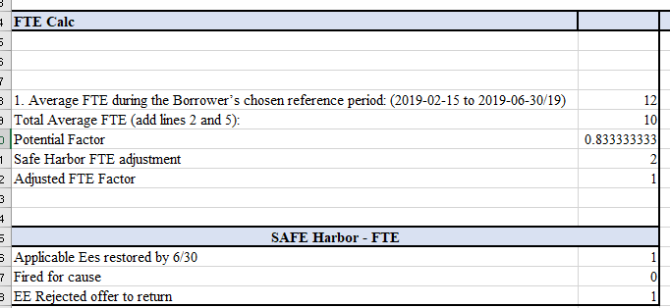
FTE Calculation
Select base period for comparison – choose lesser of 2/15/19 through 6/30/19 or 1/1/20 through 2/29/20
For each employee, enter the average number of hours per week and divide by 40. A max value for each employee is limited to 1.
OR – select simplified method which assigns a 1 for employees working 40 hours or more per week and .5 for everyone else
FTE Restoration
  Select base period by choosing the lower FTE count of the following:
    2/15/19 through 6/30/2019 OR 1/1/20 through 2/29/20.
  Calculate average FTE from base period and covered period
  Divide Covered Period FTE by Base Period & Adjust for Safe Habor
Safe Harbor
  EE rejected job offer
  Restored by 6/30
  Fired for cause

Slide 12
Alternative Payroll Covered Period
DATE OF LOAN | 4/13/2020
Biweekly payroll frequency
End of "Covered Period" | 6/8/2020
EXAMPLE OF PAYROLL SCHEDULE
Pay Date | Pay period start date (arrears/paid included) | Pay period end date (incurred included)
4/16/2020 | 3/27/2020 | 4/10/2020
4/30/2020 | 4/11/2020 | 4/25/2020
5/14/2020 | 4/26/2020 | 5/10/2020
5/28/2020 | 5/11/2020 | 5/25/2020
6/11/2020 | 5/26/2020 | 6/9/2020
all of 6/11 payroll will be included as incurred within covered perio 10 weeks of eligible payroll costs
The Alternative Payroll Covered Period, if elected, will begin on the first day of the borrower’s first pay period following the date that they receive their first PPP loan dollars, and will end on the 56th day thereafter. This assumes that all borrowers pay their employees in full on the last day of each pay period.
Employers who pay their employees after the last day of the pay period may still lose the forgiveness of payroll that is paid in arrears beyond the last day of the last pay period that is within the 56 days, and should therefore adjust their procedures accordingly.
Employers who pay monthly should adjust their procedures to pay every two weeks so that they can qualify to use the Alternative Payroll Covered Period.

Slide 13
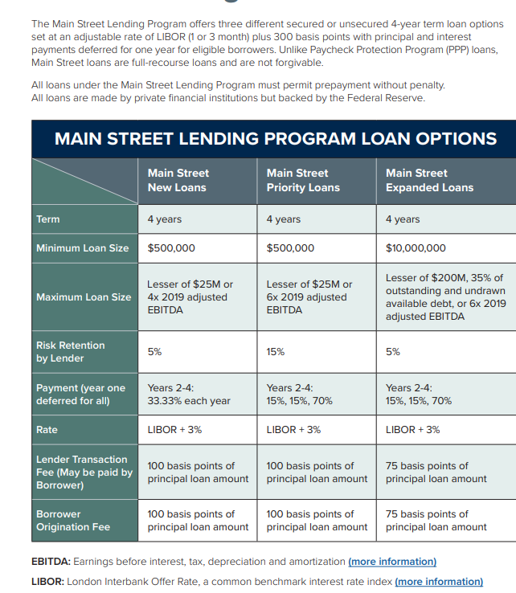
SOURCE: US CHAMBER OF COMMERCE

Slide 14
Q & A
Visit www.brinkersimpsoncares.com for the most up to date information and / or email questions to cares@brinkersimpson.com .

