Slide 1
COVID19 Financial Resource Update Webinar
Presented by:
Brinker Simpson & Company, LLC

Slide 2
DISCLAIMER
This analysis is not tax or legal advice and is not intended or written to be used, and cannot be used, for purposes of avoiding tax penalties that may be imposed on any taxpayer.
The information contained herein is general in nature and based on authorities that are subject to change. Brinker Simpson & Company, LLC guarantees neither the accuracy nor completeness of any information and is not responsible for any errors or omissions, or for results obtained by others as a result of reliance upon such information. Brinker Simpson & Company, LLC assumes no obligation to inform the reader of any changes in tax laws or other factors that could affect information contained herein. This publication does not, and is not intended to, provide legal, tax or accounting advice, and readers should consult their tax advisors concerning the application of tax laws to their particular situations.

Slide 3
AGENDA
PPP - Changes and information on the newly released forgiveness application
Main Street Lending - Lender portal launches, updates & current info.
Q & A
Overview of COVID19 Lending Programs
Economic Injury Disaster Loans – They’re Back, what you need to know.

Slide 4
Economic Injury Disaster Loans (EIDL)
Who is ELIGIBLE?
In general, all of the following entities that have suffered substantial economic injury caused by a disaster provided they were in existence on January 31, 2020:
• Businesses with 500 or fewer employees
• Cooperatives, ESOPs, and tribal small businesses with fewer than 500 employees
• Sole proprietors
• Independent contractors
• Most private nonprofits
What are the LOAN PARAMETERS?
The maximum EIDL is a $2 million working capital loan at a rate of 3.75% for businesses and 2.75% for non-profits with up to a 30-year term
Payments on Coronavirus EIDL loans are deferred for one year • Up to $200,000 can be approved without a personal guarantee
Approval can be based on a credit score and no first-year tax returns are required
Borrowers do not have to prove they could not get credit elsewhere
No collateral is required for loans of $25,000 or less. For loans of more than $25,000, general security interest in business assets will be used for collateral instead of real estate
The borrowers must allow the SBA to review its tax records
How can I access an EMERGENCY GRANT?
• Eligible applicants for an EIDL loan can receive an emergency grant of up to $10,000 within three days of application (through Dec. 31)
• There is no obligation to repay the emergency grant, and it is not necessary to have an approved EIDL loan to receive the grant.
However, if you are able to secure a PPP loan, the $10,000 grant will be subtracted from the forgiveness amount
NOTE: The Paycheck Protection Program (PPP) created by the CARES Act prohibits borrowers from taking out two loans for the same purpose. For more information on PPP loans, visit uschamber.com/sbloans
How do I APPLY? Apply online at SBA.gov/disaster
SOURCE: US CHAMBER OF COMMERCE

Slide 5
Economic Injury Disaster Loans (EIDL) - FAQs
What factors are used to approve a borrower?
Approval is based on the business’ credit score or an appropriate alternative method of determining the applicant’s ability to repay. Tax returns are not required.
How Can The Loan Proceeds Be Used?
The loan funds can be used to pay fixed debts, payroll, accounts payable and other operating expenses that could have been paid if the disaster had not occurred.
Can Businesses Apply If They Have An Existing SBA Disaster Loan?
A business with an existing SBA disaster loan can qualify for an EIDL, but the loans will not be consolidated.
Can A Business Apply For Both A PPP Loan And An EIDL?
A business can apply for both a PPP loan and an EIDL, and it can obtain both loans provided the proceeds from the two loans are not used for the same expenses. The EIDL is likely to be granted more quickly than a PPP loan. If the PPP loan is approved, it may be used to refinance the EIDL. Any advance EIDL payment will be subtracted from the PPP loan forgiveness amount.
What Documentation Will Be Required For The EIDL?
While a 2019 tax return is not required, a business must submit IRS Form 4506 T and a statement of liabilities along with the EIDL application forms.
When Can A Business Apply For An EIDL?
A business can and should begin the application process immediately. There is no obligation to accept the loan if you qualify.
What If Circumstances Require An Increase In The EIDL Loan Amount?
If the business determines the initial amount of the loan is insufficient due to changed circumstances, it can apply to increase the amount of the loan.

Slide 6
MAIN STREET LENDING PROGRAM - MSLP
As a result of the Coronavirus Aid, Relief & Economic Security (CARES) Act, the Federal Reserve has created the Main Street Lending Program to provide a total of $600 billion in financing for small and medium-sized businesses.
PUBLIC REPORTING As with other lending facilities, the Federal Reserve announced that it will follow extensive reporting procedures around the Main Street Lending Program by reporting on a monthly basis: Names and details of participants in each program Amounts borrowed and interest rate charged Overall costs, revenues, and fees for each facility
SOURCE: US CHAMBER OF COMMERCE

Slide 7
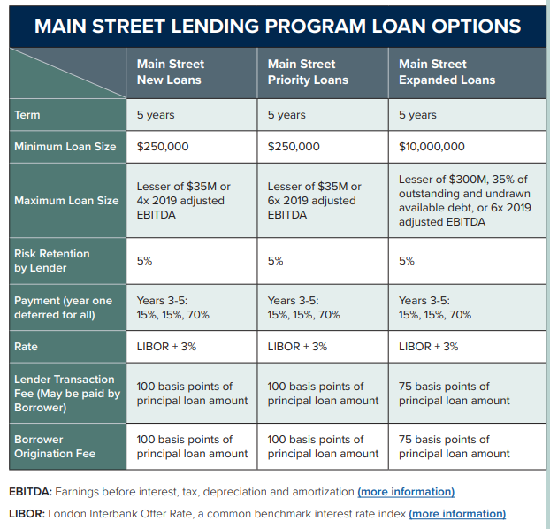
MSLP - HOW MUCH CAN I BORROW & WHAT ARE THE TERMS?
SOURCE: US CHAMBER OF COMMERCE

Slide 8
MAIN STREET LENDING PROGRAM – MSLP
Am I ELIGIBLE?
In order to be eligible for a Main Street Lending Program loan, a business must:
Have been established before March 13, 2020
Not be an ineligible business according to Small Business Administration (SBA) regulations
Have no more than 15,000 employees or 2019 annual revenues of no more than $5 billion
The SBA’s affiliation rules apply in determining the employee and revenue count
In counting employees, the Main Street Lending Program advises businesses to refer to SBA regulations by counting all full-time, parttime, seasonal, or otherwise employed persons, excluding volunteers and independent contractors
Have been created or organized in the U.S. with significant operations in and a majority of its employees based in the U.S.
Not also participate in one of the other Main Street loan facilities, as well as the Primary Market Corporate Credit Facility
Note: Businesses that received support through the SBA Paycheck Protection Program (PPP) are eligible to receive a Main Street loan
Not have received specific support pursuant to the CARES Act (Subtitle A of Title IV for air carriers, air cargo, and businesses critical to national security) All of the above criteria must be met in order to be eligible. See “Additional Borrower Criteria” section for more information
SOURCE: US CHAMBER OF COMMERCE

Slide 9
MAIN STREET LENDING PROGRAM - MSLP
How Do I APPLY?
Eligible borrowers must submit an application and other documentation required by an eligible lender. Borrowers should contact lenders for more information on whether the lender plans to participate in the program and for more information on the application process. Additional information about the application process will be announced in the future. Eligible lenders are U.S. federally-insured depository institutions (including banks, savings associations, and credit unions) as well as any U.S. branch or affiliate of a foreign bank. Nonbank financial institutions are not considered eligible lenders at this time, although the Federal Reserve is considering options to expand this list in the future

Slide 10
MAIN STREET LENDING PROGRAM – MSLP
Additional Borrower CRITERIA:
If a borrower has outstanding loans with the lender as of December 31, 2019, such loans must have an internal risk rating equivalent to “pass” in the Federal Financial Institutions Examination Council’s supervisory rating system on that date.
Additionally, lenders are expected to conduct an assessment of each potential borrower’s financial condition at the time of application.
In addition to other certifications required by statutes and regulations, the following certifications are required by eligible borrowers:
Borrowers must commit to from repaying principal balance or interest on any debt until the Main Street loan is repaid in full, unless the debt or interest payment is mandatory and due
Borrowers must commit that it will not seek to cancel or reduce any of its committed lines of credit with the Main Street lender or any other lender
Borrower must certify that it has a reasonable basis to believe that, as of the date of origination of the Main Street loan, it has the ability to meet its financial obligations for at least the next 90 days and does not expect to file for bankruptcy during that time period
Borrowers must commit to following compensation, stock repurchase, and dividend restrictions as outlined in the CARES Act for the duration of the loan term plus 1 year Exception: S-corporations and other tax pass-through entities may continue to make distributions to the extent reasonably required to cover its owners’ tax obligations in respect of the entity’s earnings refrain
SOURCE: US CHAMBER OF COMMERCE

Slide 11
MAIN STREET LENDING PROGRAM - MSLP
Retention of Employees
Eligible borrowers that participate in any Main Street Lending Program facility should make commercially reasonable efforts to maintain its payroll and retain its employees during the time that the term loan is outstanding. The Federal Reserve further clarifies that to make “commercially reasonable efforts” borrowers should undertake good-faith efforts to maintain payroll and retain employees, in light of its capacities, the economic environment, its available resources, and the business need for labor. Businesses that have already laid-off or furloughed workers as a result of COVID-19 are still eligible to apply for Main Street loans.
SOURCE: US CHAMBER OF COMMERCE

Slide 12
Paycheck Protection Program – History Lesson
The Coronavirus Aid, Relief, and Economic Security Act, also known as the CARES Act, was enacted on March 27, 2020 to provide immediate assistance to individuals, families, and businesses affected by the COVID-19 pandemic. One of the provisions of the CARES Act included a loan program authorizing the Small Business Administration to temporarily guarantee loans under a new 7(a) loan program titled the Paycheck Protection Program (PPP). Loans guaranteed under the Paycheck Protection Program (PPP) are 100 percent guaranteed by SBA, and the full principal amount of the loans may qualify for loan forgiveness.
The forgiveness component is what attracted massive interest in the program as business owners across the country are faced with government shut down orders that have caused significant declines in economic activity.
The PPP was made available to borrowers as early as April 3 and the initial funding tranche was quickly depleted. The SBA stopped accepting applications on April 16th, 2020. Additional funding for the program was made available April 24th and applications resumed shortly thereafter.
As additional details and provisions of the PPP became available, many borrowers became concerned by the lack of flexibility available if borrowers hoped to attain maximum forgiveness of the loan. Further frustrating borrowers, the application for forgiveness came a month after it’s legislative due date.
At that point, many borrowers realized they would likely be incurring a loan they could not afford and did not plan for. The rules required borrowers to rehire employees even if the business was 100% shut down or faced with significant reductions to the forgivable amount of the loan.
Many borrowers indicated making spending decisions similar to that of Montgomery Brewster in Brewster’s millions. The spending was directed towards meeting criteria for forgiveness rather than addressing critical financial needs of the business that were necessary to remain viable post pandemic.
To address these changes, Congress passed H.R. 7010 – The Paycheck Protection Program Flexibility Act of 2020 (PPPFA) and President Trump signed the legislation into law on June 5th, 2020.

Slide 13
Overview - Paycheck Protection Program
Eligible businesses include nonprofits, veterans’ organizations, tribal concerns, self-employed individuals, sole proprietorships, and independent contractors Major Benefits • Forgiveness of eligible costs, rules apply • A loan payment deferral period
Loan amount based on 2.5X average monthly payroll costs
  “Covered Costs”
  Payroll - Salaries, wages, bonuses/ hazard pay, employer portion of retirement benefits and health insurance (but not for owner’s), net self employment income, and others
  Non payroll – covered mortgages, rent, utilities
  Utilities is defined as - business payments for a service for the distribution of electricity, gas, water, telephone, transportation, or internet access for which service began before February 15, 2020 (“business utility payments”).
Funds spent over 8 OR 24 weeks following disbursement
100% Forgiveness available if certain criteria are met within the eligible timeframe:
  60% of funds used for payroll costs
  Restoration of headcount
  Restoration of compensation levels
Portion of a PPP loan that isn’t forgiven must be repaid over two OR five years.

Slide 14
Paycheck Protection Program Flexibility Act
On Friday May 28th, the House of Representatives passed the Paycheck Protection Program Flexibility Act. The Senate is expected to pass a version of the bill this week. Some of the highlights of the House version are below:
8 week covered period increased to 24 weeks or December 31, 2020 (eliminates June 30) – whichever is earlier – 8 OR 24 – no “in between”;
75% of forgivable amount spent on payroll costs reduced to 60%;
Maturity increased from 2 years to 5 years (at lender discretion for loans closed prior to 6/5/20)
Exemption based on employee availability paragraph added
Offers FTE exemptions (SAFE HARBORS) for :
  Inability to rehire anyone who was an employee as of 2/15/20 if there were also unsuccessful efforts to hire similarly qualified employees before 12/31/20
  Is able to document an inability to return to the same level of business activity as such business was operating at before February 15, 2020, due to compliance with requirements established or guidance issued by the Secretary of Health and Human Services, the Director of the Centers for Disease Control and Prevention, or the Occupational Safety and Health Administration during the period beginning on March 1, 2020, and ending December 31, 2020, related to the maintenance of standards for sanitation, social distancing, or any other worker or customer safety requirement related to COVID–19.

Slide 15
H.R. 7010 – CHANGES TO THE PPP
Change | Original | H.R. 7010 | Notes
Maturity | 2 years | 5 years | Applies to loan applications after 6/3. Other borrowers can request from lender.
Deferral of payment | 6 months | date the lender receives the forgiveness amount from the SBA | Should allow for longer deferral period; in most cases.
Covered Period | 8 weeks or 6/30/20 (earlier of) | 24 weeks or 12/31/2020 (earlier of) | Election available to retain 8 week period end
Payroll Minimum % | 75% of forgivable balance | Must spend 60% to receive any forgiveness | A co-sponsor of the bill and Senator Rubio have indicated the intent is not to establish a cliff but to maintain the sliding scale. Legislative tweak is expected).
FTE/Salary Restoration | 6/30/2020 | 12/31/2020 | as long as the FTEs or salary/hourly wage are restored to February 15th levels any time prior to the end of 2020, no reduction in forgiveness will be required
Payroll Tax Deferral from CARES Act | Available until loan forgiveness granted | Full deferral per CARES Act | 2020 deferral of employer portion of Social Security Tax to be repaid 50% in 2021 & 50% in 2022.
Exemption for lost FTEs | n/a | inability to rehire FTEs who were employees as of 2/15/20; inability to hire similarly qualified employees for unfilled roles as of 12/31; inability to return to same level of business as such business was operating at before 2/15/20 as a result of COVID mitigation measures | The 3rd option provides substantial relief and is the most impactful change relative to FTE. This should help restaurants, bars, hotels, etc avoid any reduction in forgiveness as a result of reduced headcount.

Slide 16
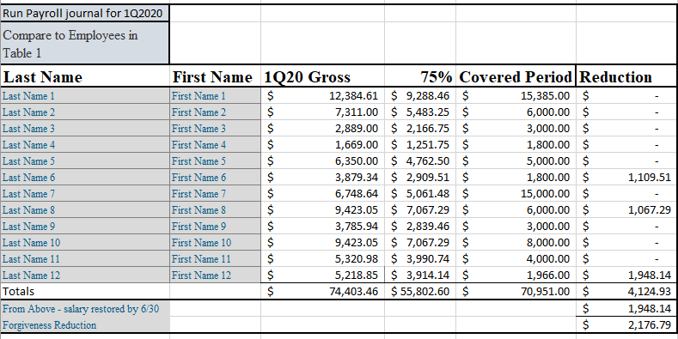
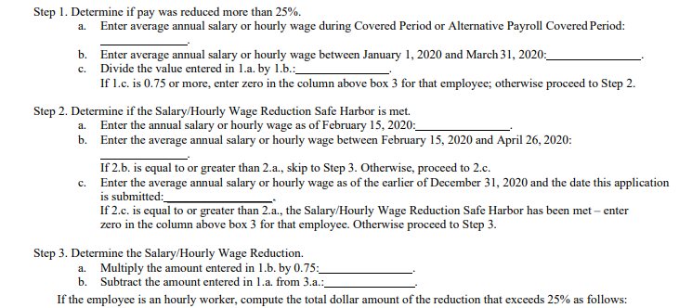
Salary @ 75% Calculation
Compares on an employee by employee basis the average salary or hourly wage paid over the covered period to 1Q20
For each employee paid during the covered period , enter their salary or hourly wage
Compare each employee to average annual over first quarter of 2020
Safe Harbor
  Salary level restored by application submission date or 12/31/20
See Calculation from app below

Slide 17
Paycheck Protection Program – Forgiveness Application
Alternate Payroll Covered Period Election
Paid and incurred are BOTH eligible as forgivable payroll costs
Exclusion of Owner Benefits
FTE = Total hours worked / 40 hours
  Option to select simplified method where employees who worked 40 hours = 1 and any employee who did not = .5
Confirmation of $100K annualized pay period to exclude salary restoration for certain employees
Sole Props 2019 - 52/8; no need to confirm 2020 income
Salary reduction is measured against the 1st quarter of 2020
Relief for headcount reduction related to employees fired for cause and / or employees who choose not to return to work

Slide 18
What We Still Don’t Know; Questions Remain
How EIDL Grant impacts forgiveness
Self Rentals
Can you apply for forgiveness in advance of 24 week end date – we don’t think so.
Tax treatment of expenses if no forgiveness decision by time of filing return
Self-employed – tax forgiveness
Benefits for owner/employees
Definition of Utilities allowed, cell phones? Trash?
Definition of transportation, what’s included
Definition of interest costs allowed
Impact of indirect impact for new FTE safe harbor (linen company impacted by restaurant orders)

Slide 19
Q & A
Visit www.brinkersimpsoncares.com for the most up to date information and / or email questions to cares@brinkersimpson.com .

